Slide 1
Chapter 8
Linux Web Servers
Notes:
sudo apt update && sudo apt upgrade -y

Slide 2
At the end of this lesson, students will be able to:
Identify and compare different types of web servers used in Linux
Set up and configure a basic Linux web server
Host a simple website using Apache or Nginx
Understand basic security and service management for web servers

Slide 3
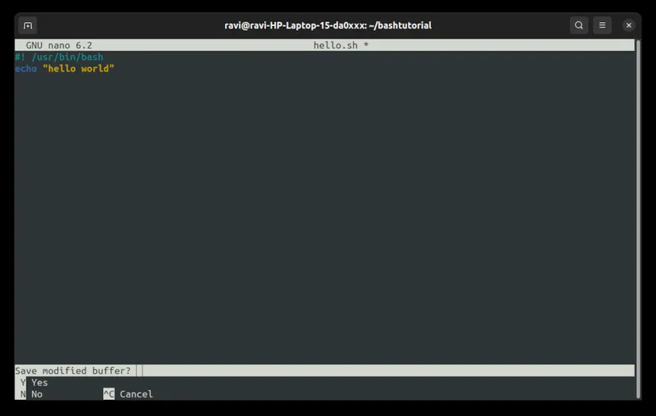
What is a Web Server?
A web server is software that serves web pages to users based on their requests via a browser (HTTP/HTTPS).
Responsibilities include:
Handling HTTP requests
Serving files (HTML, CSS, JS)
Logging access
Hosting dynamic content (with PHP, Python, etc.)

Slide 4
Common Linux Web Servers
Web Server | Meaning | Use Case
Apache | Most widely used web server. Modular and flexible. | Traditional websites, PHP apps
Nginx | High-performance server known for speed and efficiency | Static sites, reverse proxy
Lighttpd | Lightweight web server with low memory footprint | Embedded systems, IoT
Caddy | Automatic HTTPS setup and easy configuration | Fast and secure site hosting
Tomcat | Java-based web server and servlet container | Java web applications
Notes:
Most widely used web server. Modular and flexible.

Slide 5
How to Set Up Apache Web Server
Step 1: Install Apache
-sudo apt install apache2 -y
-sudo systemctl start apache2
-sudo systemctl enable apache2
Notes:
sudo systemctl restart apache2

Slide 6
Thank You
Notes:
sudo apt update && sudo apt upgrade -y

